Slide 1
Subject : English . Topic : PROTECT the ENVIRONMENT . Class : VII/I . Worked by : Xhesilda Leti , Selma Gashi , Xhiberta Leka , Paula Nuzi , Artiola Sinanasi, Armend Gjuta, Klevis Cenalia, Kristian Ndreu, Alesio Neli .
project
Notes:
This page is worked by Selma Gashi .

Slide 2
Plan :
The realization of this project we shall take advantage of all the knowledge obtained from the natural sciences and information from the Internet .
Objectives :
At the end of the Project to be able :
Talk about the environment , its protection and pollution .
To protect nearby the environment .
To explain people how to protect the environment .
Goal:
Raise the awareness of people to protect the environment.
Notes:
This page is worked by Xhesilda Leti .

Slide 3
The environment is something you are very familiar with. It's everything that makes up our surroundings and affects our ability to live on the earth—the air we breathe, the water that covers most of the earth's surface, the plants and animals around us, and much more.
In recent years, scientists have been carefully examining the ways that people affect the environment. They have found that we are causing air pollution, deforestation, acid rain, and other problems that are dangerous both to the earth and to ourselves. These days, when you hear people talk about “the environment”, they are often referring to the overall condition of our planet, or how healthy it is.
WHAT IS THE ENVIRONMENT ?
Notes:
This page is worked by Xhesilda Leti

Slide 4
I don’t want to protect the environment
I want to create a world where the environment doesn’t need protecting
Notes:
This page is worked by Xhiberta Leka .

Slide 5
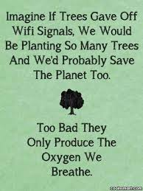
Notes:
This page is worked by Paula Nuzi

Slide 6
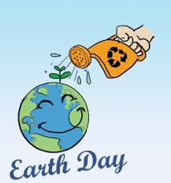
Notes:
This page is worked by Artjola Sinanasi .

Slide 7
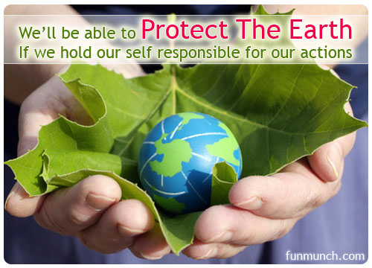
Notes:
This page is worked by Selma Gashi .

Slide 8
Pollution , we hear it every other day at school, college and read about it in newspapers.
So what is it?
Pollution occurs when pollutants contaminate the natural surroundings; which brings about changes that affect our normal lifestyles adversely. Pollutants are the key elements or components of pollution which are generally waste materials of different forms. Pollution disturbs our ecosystem and the balance in the environment. With modernization and development in our lives pollution has reached its peak; giving rise to global warming and human illness.
Pollution occurs in different forms; air, water, soil, radioactive, noise, heat/ thermal and light. Every form of pollution has two sources of occurrence; the point and the non-point sources. The point sources are easy to identify, monitor and control, whereas the non-point sources are hard to control.
Let us discuss the different types of pollutions, their causes and effects on mankind and the environment as a whole.
What is the pollution ?
Notes:
This page is worked by Xhesilda Leti .

Slide 9
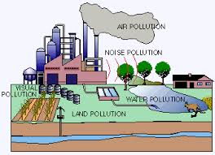
Notes:
This page is worked by Xhiberta Leka .

Slide 10
AIR POLLUTION
Air pollution occurs when gases, dust particles, fumes (or smoke) or odour are introduced into the atmosphere in a way that makes it harmful to humans, animals and plant. This is because the air becomes dirty (contaminated or unclean). The Earth is surrounded by a blanket of air (made up of various gases) called the atmosphere. The atmosphere helps protect the Earth and allow life to exist. Without it, we would be burned by the intense heat of the sun during the day or frozen by the very low temperatures at night.
Any additional gas, particles or odours that are introduced into the air (either by nature or human activity) to distort this natural balance and cause harm to living things can be called air pollution.
Things that pollute the air are called pollutants. Examples of pollutants include nitrogen oxides, carbon monoxides, hydrocarbons, sulphur oxides (usually from factories), sand or dust particles, and organic compounds that can evaporate and enter the atmosphere. There are two types of pollutants: Primary pollutants are those gases or particles that are pumped into the air to make it unclean. They include carbon monoxide from automobile (cars) exhausts and sulfur dioxide from the combustion of coal. Secondary pollutants: When pollutants in the air mix up in a chemical reaction, they form an even more dangerous chemical. Photochemical smog is an example of this, and is a secondary pollutant.
Notes:
This page is worked by Selma Gashi .

Slide 11
Why is AIR POLLUTION such an important issue ?
Your Health Dangerous chemicals such as benzene or vinyl chloride in the air causes cancer, birth defects, long term injury to the lungs, as well as brain and nerve damage when people breath it. And in some cases, breathing these chemicals can even cause death. Breathing contaminated air can make your eyes and nose burn and trigger respiratory problems, especially for people with asthma. In recent years, scientists have shown that air pollution from cars, factories and power plants is a major cause of asthma attacks. For example: "And more than 131 million Americans — over 40 percent of the nation's population - live in areas with bad air. Roughly 30 percent of childhood asthma is due to environmental exposures, costing the nation $2 billion per year". Source: Natural Resources Defense Council:
The Environment Poisonous air pollutants (toxic chemicals in the air) can form acid rain. It can also form dangerous ground level ozone. These destroy trees, crops, farms, animals and continue to make water bodies harmful to humans and animals that live and depend on water.
The Economy
The effect of air pollution on the economy may be a derived one. In simple language, the economy thrives when people are healthy, and business that depend on cultivated raw materials and natural resources are running at full efficiency. Air pollution reduces agricultural crop and commercial forest yields by billions of dollars each year. This in addition to people staying off work for health reasons can cost the economy greatly. When pollution occurs in the air, it can easily travel and spread, and because we breathe in air, we cannot easily avoid it.
Notes:
This page is worked by Selma Gashi .

Slide 12
WHAT CAUSES OF AIR POLLUTION ? Air pollution can result from both human and natural actions. Natural events that pollute the air include forest fires, volcanic eruptions, wind erosion, pollen dispersal, evaporation of organic compounds and natural radioactivity. Pollution from natural occurrences are not very often. Human activities that result in air pollution include:
1. Emissions from industries and manufacturing activities Consider a typical manufacturing plant: You will notice that there are long tubes (called chimneys) erected high into the air, with lots of smoke and fumes coming out of it. Waste incinerators, manufacturing industries and power plants emit high levels of carbon monoxide, organic compounds, and chemicals into the air. This happens almost everywhere that people live. Petroleum refineries also release lots of hydrocarbons into the air.
2. Burning Fossil Fuels After the industrial age, transportation has become a key part of our lives. Cars and heavy duty trucks, trains, shipping vessels and airplanes all burn lots of fossil fuels to work. Emissions from automobile engines contain both primary and secondary pollutants. This is a major cause of pollution, and one that is very difficult to manage. This is because humans rely heavily on vehicles and engines for transporting people, good and services. Fumes from car exhauts contain dangerous gases such as carbon monoxide, oxides of nitrogen, hydrocarbons and particulates. On their own, they cause great harm to people who breath them. Additionally, they react with environmental gases to create further toxic gases.
3. Household and Farming Chemicals Crop dusting, fumigating homes, household cleaning products or painting supplies, over the counter insect/pest killers, fertilizer dust emit harmful chemicals into the air and cause pollution. In many case, when we use these chemicals at home or offices with no or little ventilation, we may fall ill if we breathe them.
Notes:
This page is worked by Selma Gashi .

Slide 13
WHAT ARE THE EFFECTS OF AIR POLLUTION ?
Below are a few key effects of air pollution.
Acidification: Chemical reactions involving air pollutants can create acidic compounds which can cause harm to vegetation and buildings. Sometimes, when an air pollutant, such as sulfuric acid combines with the water droplets that make up clouds, the water droplets become acidic, forming acid rain. When acid rain falls over an area, it can kill trees and harm animals, fish, and other wildlife. Acid rain destroys the leaves of plants. When acid rain infiltrates into soils, it changes the chemistry of the soil making it unfit for many living things that rely on soil as a habitat or for nutrition. Acid rain also changes the chemistry of the lakes and streams that the rainwater flows into, harming fish and other aquatic life.
Eutrophication:
Rain can carry and deposit the Nitrogen in some pollutants on rivers and soils. This will adversely affect the nutrients in the soil and water bodies. This can result in algae growth in lakes and water bodies, and make conditions for other living organism harmful.
Ground-level ozone: Chemical reactions involving air pollutants create a poisonous gas ozone (O3). Gas Ozone can affect people’s health and can damage vegetation types and some animal life too.
Particulate matter: Air pollutants can be in the form of particulate matter which can be very harmful to our health. The level of effect usually depends on the length of time of exposure, as well the kind and concentration of chemicals and particles exposed to. Short-term effects include irritation to the eyes, nose and throat, and upper respiratory infections such as bronchitis and pneumonia. Others include headaches, nausea, and allergic reactions. Short-term air pollution can aggravate the medical conditions of individuals with asthma and emphysema. Long-term health effects can include chronic respiratory disease, lung cancer , heart disease, and even damage to the brain, nerves, liver, or kidneys. Continual exposure to air pollution affects the lungs of growing children and may aggravate or complicate medical conditions in the elderly.
Notes:
This page is worked by Selma Gashi .

Slide 14
AIR POLLUTON prevention , monitoring and solution
Solution efforts on pollution is always a big problem. This is why prevention interventions are always a better way of controlling air pollution. These prevention methods can either come from government (laws) or by individual actions. In many big cities, monitoring equipment have been installed at many points in the city. Authorities read them regularly to check the quality of air. Let's see more below:
Government (or community) level prevention Governments throughout the world have already taken action against air pollution by introducing green energy. Some governments are investing in wind energy andsolar energy , as well as other renewable energy , to minimize burning of fossil fuels, which cause heavy air pollution. Governments are also forcing companies to be more responsible with their manufacturing activities, so that even though they still cause pollution, they are a lot controlled. Companies are also building more energy efficient cars, which pollute less than before.
Individual Level Prevention Encourage your family to use the bus, train or bike when commuting. If we all do this, there will be less cars on road and less fumes.
Use energy (light, water, boiler, kettle and fire woods) wisely. This is because lots of fossil fuels are burned to generate electricity, and so if we can cut down the use, we will also cut down the amount of pollution we create.
Recycle and re-use things. This will minimize the dependence of producing new things. Remember manufacturing industries create a lot of pollution, so if we can re-use things like shopping plastic bags, clothing, paper and bottles, it can help.
Notes:
This page is worked by Selma Gashi .

Slide 15
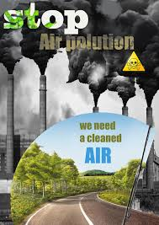
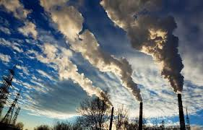
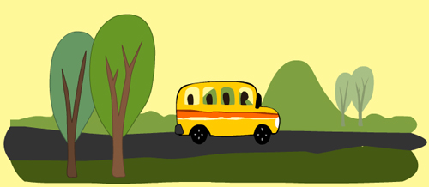
Notes:
This page is worked by Selma Gashi .

Slide 16
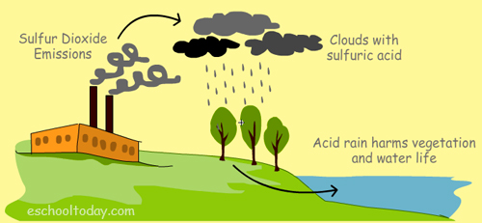
Notes:
This page is worked by Selma Gashi .

Slide 17
WATER POLLUTION
Water pollution occurs when pollutants (particles, chemicals or substances that make water contaminated) are discharged directly or indirectly into water bodies without enough treatment to get rid of harmful compounds. Pollutants get into water mainly by human causes or factors. Water pollution is the second most imperative environmental concern along with air polltion . Any change or modification in the physical, chemical and biological properties of water that will have a detrimental consequence on living things is water pollution.
The water pollution problem Water covers over 70% of the Earth’s surface. It is a very important resource for people and the environment. Water pollution affects drinking water, rivers, lakes and oceans all over the world. In many developing countries, it is usually a leading cause of death, by people drinking from polluted water sources. More to this, water pollution affects not only individual living species, but also populations and entire functioning ecosystems that exists in the waters. Humans have now realised the importance of clean water as a foundation for life. In recent time, more and more organisations and councils are working hard to educate, protect, restore waterways and encourage practices that help keep waters from contamination, and also to preserve water ecosystems from destruction.
Notes:
This page is worked by Xhiberta Leka .

Slide 18
TYPES OF WATER POLLUTION
There are many types of water pollution because water comes from many sources. Here are a few types of water pollution:
1. Nutrients Pollution Some wastewater, fertilizers and sewage contain high levels of nutrients. If they end up in water bodies, they encourage algae and weed growth in the water. This will make the water undrinkable, and even clog filters. Too much algae will also use up all the oxygen in the water, and other water organisms in the water will die out of oxygen starvation.
2. Surface water pollution Surface water includes natural water found on the earth's surface, like rivers, lakes, lagoons and oceans. Hazardous substances coming into contact with this surface water, dissolving or mixing physically with the water can be called surface water pollution.
3. Oxygen Depleting Water bodies have micro-organisms. These include aerobic and anaerobic organisms. When to much biodegradable matter (things that easily decay) end up in water, it encourages more microorganism growth, and they use up more oxygen in the water. If oxygen is depleted, aerobic organisms die, and anaerobic organism grow more to produce harmful toxins such as ammonia and sulfides.
Notes:
This page is worked by Xhesila Leti .

Slide 19
4. Ground water pollution When humans apply pesticides and chemicals to soils, they are washed deep into the ground by rain water. This gets to underground water, causing pollution underground. This means when we dig wells and bore holes to get water from underground, it needs to be checked for ground water pollution.
5. Microbiological In many communities in the world, people drink untreated water (straight from a river or stream). Sometimes there is natural pollution caused by micro-organisms like viruses, bacteria and protozoa. This natural pollution can cause fishes and other water life to die. They can also cause serious illness to humans who drink from such waters.
6. Suspended Matter Some pollutants (substances, particles and chemicals) do not easily dissolve in water. This kind of material is called particulate matter. Some suspended pollutants later settle under the water body. This can harm and even kill aquatic life that live at the floor of water bodies.
7. Chemical Water Pollution Many industries and farmers work with chemicals that end up in water. This is common with Point-source Pollution. These include chemicals that are used to control weeds, insects and pests. Metals and solvents from industries can pollute water bodies. These are poisonous to many forms of aquatic life and may slow their development, make them infertile and kill them.
8. Oil Spillage Oil spills usually have only a localized effect on wildlife but can spread for miles. The oil can cause the death to many fish and get stuck to the feathers of seabirds causing them to lose their ability to fly.
Notes:
This page is worked by Xhesilda Leti .

Slide 20
Other causes of water pollution
Apart from the industrial causes of water pollution 1. Sewage and waste water Everyday, we cook, do laundry, flush the toilet, wash our cars, shower and do many things that use water. Think about how we use water in schools, hospitals and public places. Where do you think all the water, liquid waste, toilet and urine ends up? In many developed communities, this waste water and soluble waste (called sewage) is trated , cleaned and dumped into the sea or river. Even though they are treated, they are never the same as fresh water. In some not-so-developed countries, the sewage is not treated, but quickly dumped into the sea or water bodies. This is VERY dangerous because they contaminate the environment and water bodies and bring many deadly diseases to us.
2.Septic Tanks Every domestic (home) toilet is connected to septic tank usually located outside the house. Each time poop is flushed down the toilet, it goes into this tank, where the solid part is separated from the liquid part. Biological processes are used to break down the solids and the liquid is usually drained out into a land drainage system. From this stage, it can escape into the soil and nearby water bodies.
Notes:
This page is worked by Xhiberta Leka .

Slide 21
3.Ocean and marine dumping Again, think of the rubbish we all make each day. Paper waste, food waste, plastic, rubber, metallic and aluminum waste. In some countries, they are deposited into the sea. All these waste types take time to decompose. For example, it is know that paper takes about 6 weeks, aluminum takes about 200 years and glass takes even more years. When these end up in the sea, they harm sea animals and cause a lot of water animal deaths.
4.Underground storage and tube leakages Many liquid products (petroleum products) are stored in metal and steel tubes underground. Other sewage systems run in underground tubes. Overtime, they rust and begin to leak. If that happens, they contaminate the soils, and the liquids in them end up in many nearby water bodies.
5. Atmospheric Atmospheric deposition is the pollution of water bodies caused by air pollution. Each time the air is polluted with sulphur dioxide and nitrogen oxide, they mix with water particles in the air and form a toxic substance. This falls as acid rain to the ground, and gets washed into water bodies. The result is that, water bodies also get contaminated and this affects animals and water organisms.
Notes:
This page is worked by Xhiberta Leka .

Slide 22
Effects of water pollution
You will notice in the previous pages that water pollution is very harmful to humans, animals and water life. The effects can be catastrophic, depending on the kind of chemicals, concentrations of the pollutants and where there are polluted. Below, we shall see a summary of the effects of water pollution.
The effects of water pollution are varied and depend on what chemicals are dumped and in which locations. Many water bodies near urban areas (cities and towns) are highly polluted. This is the result of both garbage dumped by individuals and dangerous chemicals legally or illegally dumped by manufacturing industries, health centers, schools and market places.
Death of aquatic (water) animals The main problem caused by water pollution is that it kills life that depends on these water bodies. Dead fish, crabs, birds and sea gulls, dolphins, and many other animals often wind up on beaches, killed by pollutants in their habitat (living environment).
Disruption of food-chains Pollution disrupts the natural food chain as well. Pollutants such as lead and cadmium are eaten by tiny animals. Later, these animals are consumed by fish and shellfish, and the food chain continues to be disrupted at all higher levels.
Notes:
This page is worked by Xhiberta Leka .

Slide 23
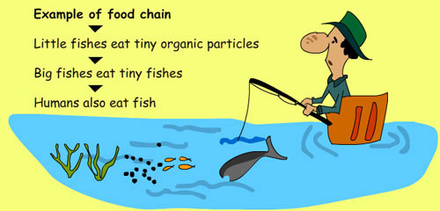
Diseases Eventually, humans are affected by this process as well. People can get diseases such as hepatitis by eating seafood that has been poisoned. In many poor nations, there is always outbreak of cholera and diseases as a result of poor drinking water treatment from contaminated waters.
Destruction of ecosystems Ecosystems (the interaction of living things in a place, depending on each other for life) can be severely changed or destroyed by water pollution. Many areas are now being affected by careless human pollution, and this pollution is coming back to hurt humans in many ways.
Notes:
This page is worked by Xhiberta Leka .

Slide 24
Prevention of water pollution
Dealing with water pollution is something that everyone (including governments and local councils) needs to get involved with. Here are a few things you can do to help. Learning about the issue (like you are doing) is the greatest and most important step to take. Here are a few more:
You can help:
1) Never throw rubbish away anyhow. Always look for the correct waste bin. If there is none around, please take it home and put it in your trash can. This includes places like the beach, riverside and water bodies.
2) Use water wisely. Do not keep the tap running when not in use. Also, you can reduce the amount of water you use in washing and bathing. If we all do this, we can significantly prevent water shortages and reduce the amount of dirty water that needs treatment.
3)Do not throw chemicals, oils, paints and medicines down the sink drain, or the toilet. In many cities, your local environment office can help with the disposal of medicines and chemicals. Check with your local authorities if there is a chemical disposal plan for local residents.
Notes:
This page is worked by Xhiberta Leka .

Slide 25
4)Buy more environmentally safe cleaning liquids for use at home and other public places. They are less dangerous to the environment.
5)If you use chemicals and pesticides for your gardens and farms, be mindful not to overuse pesticides and fertilizers. This will reduce runoffs of the chemical into nearby water sources. Start looking at options of composting and using organic manure instead.
6)If you live close to a water body, try to plant lots of trees and flowers around your home, so that when it rains, chemicals from your home does not easily drain into the water.
7)Governments, local councils and laws Many governments have very strict laws that help minimize water pollution. These laws are usually directed at industries, hospitals, schools and market areas on how to dispose, treat and manage sewage. Do you know the laws in your country? This is the time to find out. In many developed cities, waste or sewage treatment is very efficient, and designed to minimise pollution of water bodies. There are also lots of organizations and groups that help educate people on the dangers of water pollution. It is always great to join these groups, because they regularly encourage other members of their communities to have a better attitude towards water.
Notes:
This page is worked by Xhiberta Leka .

Slide 26
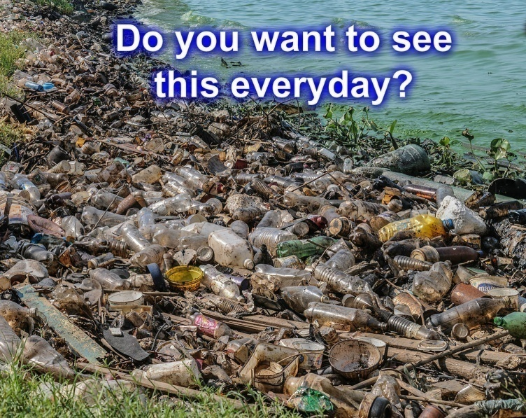
Notes:
This page is worked by Xhesilda Leti .

Slide 27
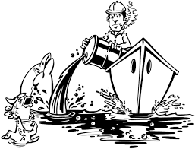
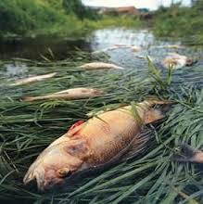
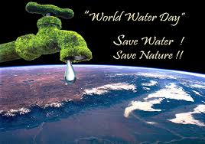
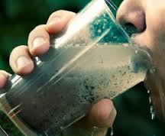
Notes:
This page is worked by Xhesilda Leti .

Slide 28
Notes:
This page is worked by Xhiberta Leka .

Slide 29
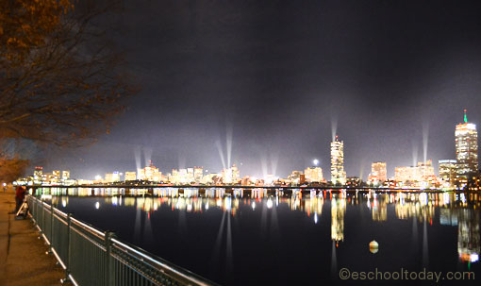
LIGHT POLLUTION Light pollution is the excessive and prolonged use of artificial lights, in a way that results in brightening of night skies, disrupting natural cycles and activities of wildlife, health probelms in humans, as well as preventing humans from observing stars and other planets. In other definitions, it does not only have to do with the sky, but anywhere that artificial lights are used, where they are not intended to. Other terms often used for light pollution are ‘photopollution’ and'luminous pollution'.
Note that this is not only a city center problem. There is also light pollution when you use too much light in your compound that affects the comfort and health of your neigbours. This could be your outdoor light ‘s intrusion into other people’s bedrooms. This can be called nuisance. Too much light indoors also is classified as indoor light pollution if it is wasteful and it has effect on the health of people living in that room.
Notes:
This page is worked by Paula Nuzi .

Slide 30
What are the types of light pollution? Light pollution comes in many forms. The most common include the following:
Sky glow: This is the bright orange-pink glow that hangs over cities and towns in the night. Sky glow could be caused by natural factors, but also often caused by inefficient and artificial lights shinning needlessly into the sky, and further scattered by airborne dust particles, gas and water droplets. Sky glow is better seen during poor weather conditions where more particles are present in the atmosphere. Astronomers are having increasing problems with sky glow as it interferes with the viewing of celestial (outer space) objects. For example, at the Mars Hill Observatory in Flagstaff, Arizona, sky brightness is reported to have increased by 0.5 magnitude from 1976 to 1988 .
Glare: This is the effect produced when the eyes are exposed to bright light. If a bright flashlight is directed at your face in a dark place, you notice that it almost blinds you and suddenly you cannot see other objects or shadows around you. This is particularly dangerous when driving, because bright lights from cars coming towards you reduce your vision and puts pedestrians and other road users at risk. The most common causes of glare include bright streetlights and car lights.
Notes:
This page is worked by Paula Nuzi .

Slide 31
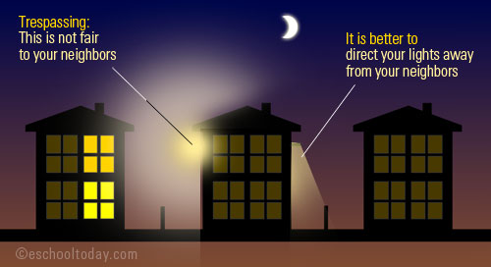
This occurs when light goes over its intended range. Think of your neighbor’s security light shining through your bedroom windows and lighting up your room all night. Light spillover is a very common subject of complaint by many residential dwellers and is a problem that can be easily fixed with the right lighting equipment. Main sources of light trespass include dusk-to-dawn lights, sports field lighting and commercial lighting.
Notes:
This page is worked by Paula Nuzi .

Slide 32
What are the effects of light pollution?
1) Waste of resources: It costs a lot of money to light up homes, public places, sports and commercial places. Apart from the fact that tax payers pay needlessly for this, the nation uses millions of tons of oil and coal to produce the power needed to light the sky. Meanwhile, the environmental cost of producing this energy is another worrying issue that can be discussed at another time. In the USA, 8% of its total energy is used for outdoor lighting, and out of that, 80% is used for commercial and public exterior lighting.— Darksky 2) Loss of historical and cultural value: Astronomers are concerned that not only do they have difficulty reading and viewing activities in the sky and outer space, but also we are loosing the wonderful dark sky view with stars and other space objects that we used to enjoy. Many young people growing up in the city may not have the opportunity to experience this awesome scene, if we continue to direct more light into the sky. 3)Health implications: Disability glare, eye strain, loss of vision and stress that people get from glare and spillovers are worth mentioning. Our eyes naturally adjust during day and night so we can see things properly. Too much light can harm our eyes and also the harm the hormones (such as melatonin) that does this job.
4)Wildlife: Many insects, birds, mammals and reptiles are photoperiodic in nature. Examples include sea turtles. Many aspects of their physiology and behavior are influenced by day–night or circadian rhythms. This means their eating, mating, growth and development, movement and other activities are in relation to the balance of day and night. Artificial lights, even in small amounts can distort their natural operations and cycle. Thousands of deer and animals are killed on the roads by vehicles in the evenings, because the glare of these cars blind them and are unable to run off the streets before they are knocked down.
Notes:
This page is worked by Paula Nuzi .

Slide 33
Here are a few things governments and engineers can do: 1)Engineers must invest and use new lighting technology that uses the full cut-off concept. This way, lights escaping upwards from large commercial places, stadiums, theaters and public places will be reduced. For example about 30% of road light fittings in the UK have reached their lifespan and need changing. This is a good time to engage new technology to ensure that the replaced fittings will not cause too much light pollution .
2)Government policies on the use of lights must be stepped in a way that forces consumers to buy more energy-reduced light (and also not too much bright lights). These policies must be enforced.
3)Research shows that too much lights does not necessarily improve visibility. This means that smart choices can be made to improve visibility in the night without splashing too much light into the sky.
4)Individuals must also begin to install motion sensor-lights and bulbs in their homes, so that they are not kept on all night. Garden and landscape lights must be used effectively and should not be too bright to bother others.
It is important that education of light pollution and its consequences are stepped up and taught in all schools, just as water, land and air pollution.
Notes:
This page is worked by Paula Nuzi.

Slide 34
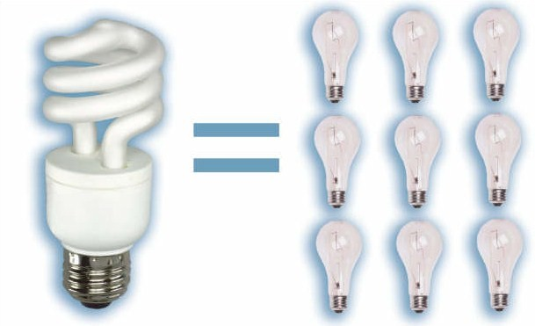
Notes:
This page is worked by Paula Nuzi .

Slide 35
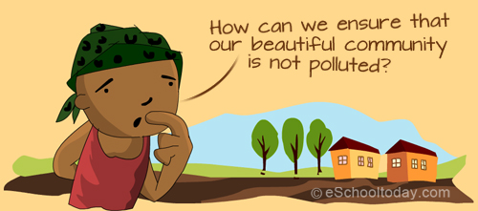
LAND POLLUTION Land pollution is the deterioration (destruction) of the earth’s land surfaces, often directly or indirectly as a result of man’s activities and their misuse of land resources. It occurs when waste is not disposed off properly, or can occur when humans throw chemicals unto the soil in the form of pesticides, insecticides and fertilizers during agricultural practices. Exploitation of minerals (mining activities) has also contributed to the destruction of the earth’s surface. Since the Industrial Revolution, natural habitats have been destroyed, and environments have been polluted, causing diseases in both humans and many other species of animals. Human actions have also caused many large areas of land to lose or reduce their capacity to support life forms and ecosystems. This is know as land degradation. Note that land degradation can result from many factors, and land pollution is only one of them.In the lesson, we shall see the more about Land and Environmental Pollution, the sources of the pollution, its consequences and a few things we can do to prevent further pollution and protect our environment.
Notes:
This page is worked by Artiola Sinanasi .

Slide 36
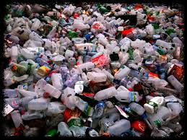
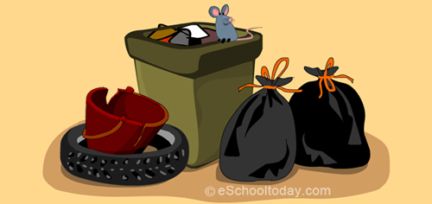
Types of land pollution. There are different types of land pollution. Many publications group them differently. Let us see these four main types: 1)Solid Waste These include all the various kinds of rubbish we make at home, school, hospitals, market and work places. Things like paper, plastic containers, bottles, cans, food and even used cars and broken electronic goods, broken furniture and hospital waste are all examples of solid waste. Some of these are biodegradable (meaning they easily rot or decay into organic matter). Examples include food droppings, paper products as well as vegetation (like grass and twigs). Others are not biodegradable, and they include plastics, metals and aluminum cans, broken computer and car parts. Because these do not easily decay, they pile up in landfills (a place where all the city’s rubbish are sent), where they stay for thousands of years. These bring great harm to the land and people around it.
Notes:
This page is worked by Artiola Sinanasi .

Slide 37
2)Pesticides and Fertilizers Many farming activities engage in the application of fertilizers, pesticides and insecticides for higher crop yield. This is good because we get more food, but can you think of what happens to the chemicals that end up on the crops and soils? Sometimes, insects and small animals are killed and bigger animals that eat tiny animals (as in food chains) are also harmed
3) Chemicals Chemical and nuclear power plants produce waste materials that have to be stored somewhere. Fertilizer, insecticides, pesticides, pharmaceuticals manufacturers also produce lots of solid and liquid waste. In many cases they are stored in an environmentally safe way, but there are some that find their way into landfills and other less safe storage facilities. Sometimes they also find their way into leaking pipes and gutters. They end up polluting soils and making crops harmful to our health.
4) Deforestation Humans depend on trees for many things including life. Trees absorb carbon dioxide (a green hause gas)from the air and enrich the air with Oxygen, which is needed for life. Trees provide wood for humans and a habitat to many land animals, insects and birds. Trees also, help replenish soils and help retain nutrients being washed away. Unfortunately, we have cut down millions of acres of tree for wood, construction, farming and mining purposes, and never planted new trees back. This is a type of land pollution.
Notes:
This page is worked by Artiola Sinanasi .

Slide 38
Effects of land pollution.
There can be catastrophic consequences of land pollution in relation to humans, animals, water and soils. The effects are even worse if the garbage is not separated into organic, re-usable and recyclable waste. A)Contaminated lands and environments can: 1. Cause problems in the human respiratory system. 2.Cause problems on the skin. 3.Cause various kinds of cancers.
B)The toxic materials that pollute the soil can getinto the human body directly by: 1.Coming into contact with the skin. 2.Being washed into water sources like reservoirs and rivers. 3.Eating fruits and vegetables that have been grown in polluted soil. 4.Breathing in polluted dust or particles.
C)Dump sites and landfills also come with serious problems like 1.Very bad smell and odour in the town. 2.Landfills breed rodents like rats, mice and insects, who in-turn transmit diseases. 3.Landfills in towns do not attract tourists to the town. The town will loose revenue. 4.Many landfills are always burning and they cause further air pollution.
Notes:
This page is worked by Artiola Sinanasi .

Slide 39
How to prevent land pollution ? Here are a few other tips on how you can help reduce land pollution:
1.People should be educated and made aware about the harmful effects of littering. Discuss with friends and family and talk about it.
2.Reuse any items that you can. Items like clothing, bottles, wrapping paper and shopping bags can be used over and over again, rather than buying new things. The greatest prevention to land pollution is in the three ‘R's’ … Reduce Waste, Re-use things and Recycle things. This is true even for governments. They can also use the three ‘R’ rule to minimize the amount of waste that ends up in landfills. After the three 'R's, remember to turn the rest of the garbge into compost.
3. Personal litter should be disposed properly. We can separate household waste at home for recycling. More than half of our household waste could be recycled or re-used but once it is mixed up, it becomes more difficult to separate different components for recycling. This is also true for waste we make at school or hospitals.
4.Buy biodegradable products.
5. Store all liquid chemicals and waste in spill-proof containers.
6.Eat organic foods that are grown without pesticides. Look out for fertilizer or pesticide free products when you go to the market .
Notes:
This page is worked by Artiola Sinanasi .

Slide 40
7.Don’t use pesticides if you can.
8.Use a drip tray to collect engine oil.
9.Buy products that have little packaging.
10.Don’t dump motor oil on the ground.
Notes:
This page is worked by Artiola Sinanasi .

Slide 41
Notes:
This page is worked by Armend Gjuta

Slide 42
Sound is essential to our daily lives, but noise is not. Noise is generally used as an unwanted sound, or sound which produces unpleasant effects and discomfort on the ears. Sound becomes unwanted when it either interferes with normal activities such as sleeping, conversation, or disrupts or diminishes one’s quality of life. Not all noise can be called noise pollution. If it does not happen reqularly, it may be termed as 'Nuisance' Scientists also believe that its not only humans who are affected. For example, water animals are subjected to noise by submarines and big ships on the ocean, and chain-saw operations by timber companies also create extreme noise to animals in the forests. Generally, noise is produced by household gadgets, big trucks, vehicles and motorbikes on the road, jet planes and helicopters hovering over cites, loud speakers etc. Noise (or sound) is measured in the units of decibels and is denoted by the dB. Noise which is more than 115 dB is tolerant. The industrial limit of sound in the industries must be 75 dB according to the World Health Organization. Noise is considered as environmental pollution, even though it is thought to have less damage on humans than water, air or land pollution. But people who are affected by severe noise pollution know that it is a massive issue that needs attention.
Noise pollution
Notes:
This page is worked by Armend Gjuta .

Slide 43
Effects of Noise Pollution
Generally, problems caused by noise pollution include stress related illnesses, speech interference, hearing loss, sleep disruption, and lost productivity. Most importantly, there are two major effects we can look at: Hearing The immediate and acute effect of noise pollution to a person, over a period of time, is impairment of hearing. Prolonged exposure to impulsive noise to a person will damage their eardrum, which may result in a permanent hearing. Effects on general health Health effects of noise include anxiety and stress reaction and in extreme cases fright. The physiological manifestations are headaches, irritability and nervousness, feeling of fatigue and decreases work efficiency. For example, being pounded by the siren of fire fighters, police or ambulance in your city all night everyday leave people (especially elderly people) stresses and tired in the morning. Its is worth noting that these effects may not sound troubling, but the truth is, with time, the consequences can be very worrying.
Notes:
This page is worked by Armend Gjuta

Slide 44
Notes:
This page is worked by Armend Gjuta

Slide 45
Notes:
This page is worked by Xhesilda Leti

Slide 46
GLOBAL WARMING
Global warming is a hot tipic that shows little sign of cooling down.The Earth's cimate is changing,but precisely whether we can stop the process is unercertain.Over the last century average global temperatures have increased by approximately one degree while in Alaska,North-Western Canada and Eastern Russia is believed average temperatures have increased by as much as three to four degrees.In the nothen hemisphere ,the spring thaw occurs nine days earlier and the winter freeze happens about ten days later than it did 150 years ago and the last two decades have been the warmest ever recorded since the mid-1800s.Global warming has serious repercussions for life on the planet.One immediate result is that many animal species are fighting for survival .One example is the polar bear population that lives in Hudson Bay area of Northern Manitoba .The reduction in ice ,as well as a shorter winter season ,means that the bears have a reduced hunting period .For some bears, their yearly food in take has decreased by as much as ten kg. Some of them are not able to survive the summer fast period because they have not stored enough energy to sustain themselves. They need the ice to cover the sea during the winter months so they can hunt for seals ,their main source of food.However,the sea ice is melting and breaking up because of global warming. Glaciers and ice bergs are receding and disappearing at alarming rates. Studies suggest that the West Hudson Bay polar bear population has decreased by as much as 20% in just ten years.Warmer weather in the region also has a cataclysmic effect on female bears and their maternity dens.Many dens collapse in the spring due to heavy rains and trap the mothres and their cubs.In some instances,the increased temperatures melt the frosen grown well when the dens are located also causing them to colapse unless the mother and cubs are rescued most of this animals die.If we continue to do nothing to reduce the smission of greenhouse gases and continue to pollute our environment,ice conditions in the Hundson Bay area will not be able to sustain and support its population of polar bears and we will have forced yet another species into ectinction.
Notes:
This page is worked by Xhesilda Leti

Slide 47
Notes:
This page is worked by Paula Nuzi

Slide 48
City farms offer volunteering and training opportunities ,a place to take schoolchildren on an educational visit,a fun day out for the family and simply the chance to relax and enjoy nature in an urban setting .There are over 60 across the country and 18 in London .Admission is usually free and they attract nearly 3 million visitors each year . They are designed to help children and adults in urban areas to enjoy natyral environments and learn about wildlife . Most city farms run training courses as well as catering for school visits. Some offer holiday schemes and facilities for various activities such as horse riding. They are managed by the local communities who come together and work to make the farms successful.Most people who work on them are volunteers who give up their spare time to help out .A variety of traditional farm stock is found on each farm.These includcows,sheep,poultry,goats and horses,all of which are fed and breeds and unusual animals such as alpacas.When farm staff are avaiale,visitors are able to touch and hold the animals and if you're there at mealtimes you may even be able to help feed them.Some farms have large ponds where plant and insects can be seen in their natural habitats.Of course city farms can be expensive to run,even if the staff do work for free.The city farms avoid any financial problems though,by selling their products to public and the income is used to help provide animal feed tools equipment and so on.Many farms breeding programes so they have enough animals to keep the farm stocked and to sell as well.
Farms in the city
Notes:
This page is worked by Xhiberta Leka .

Slide 49
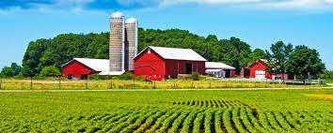
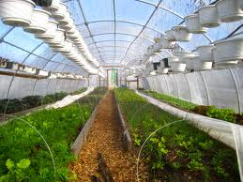
Notes:
This page is worked by Xhiberta Leka .

Slide 50
Ecology is the study of the relationships between living organisms, including humans, and their physical environment; it seeks to understand the vital connections between plants and animals and the world around them. Ecology also provides information about the benefits of ecosystems and how we can use Earth's resources in ways that leave the environment healthy for future generations.
Ecologists study these relationships among organisms and habitats of many different sizes, ranging from the study of microscopic bacteria growing in a fish tank, to the complex interactions between the thousands of plant, animal, and other communities found in a desert.
Ecologists also study many kinds of environments. For example, ecologists may study microbes living in the soil under your feet or animals and plants in a rainforest or the ocean.
Ecology
Notes:
This page is worked by Kristian Ndreu .

Slide 51
Mother Earth gives her gifts for all to share,
She gives them freely, yet she's still aware,
That things are changing, perhaps for the worse.
How much more can she give if our future is cursed?
It's way past time to put Mother Earth first,
To clean up the water before we all thirst,
To clean up the air before our lungs sicken,
To renew the soil and feel it quicken.
How long until the point of no return?
How much longer until we all finally learn,
That to this task we all must rise.
And stop abusing Mother Earth before she dies.
Mother Earth's Gifts
Notes:
This page is worked by Klevis Cenalia .

Slide 52
Small Actions
=
Big Changes
Notes:
This page is worked by Kristian Ndreu .

Slide 53
Save the EARTH
it’s the only planet
with LIFE !
Notes:
This page is worked by Alesio Neli .

