Slide 1
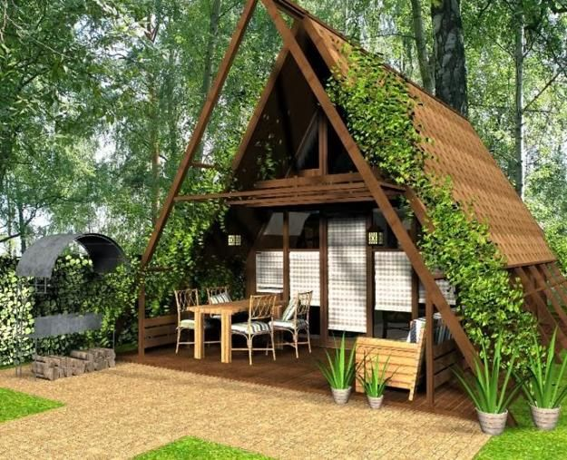
PROJECT
TOPIC:UNDERGROUND HOUSES IN THE WOLD.
WORKET BY:RISTI KOCIBELLI AND KEVIN LICO

Slide 2
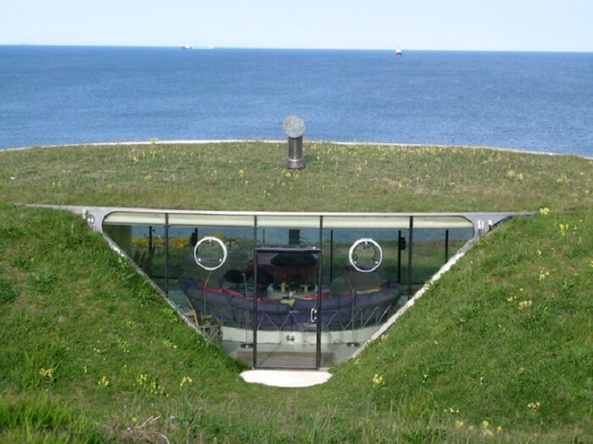

Slide 3
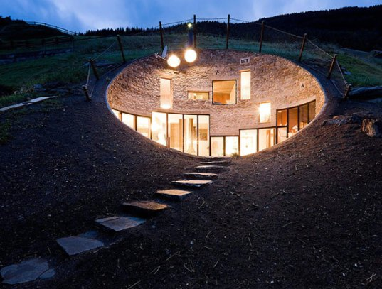
Underground houses:
STUNNING BURIED HOUSE IN VALS, SWITZERLAND
Unlike other homes this clever dwelling was made specifically so that it would blend in perfectly with the breathtaking landscape in Vals, Switzerland. Designed by the architects of SeArch and Christian Müller, the home is hidden on all sides save for one and by building the house underground, the architects were able to almost completely eliminate the need for heating or cooling in the winter and summer months.

Slide 4
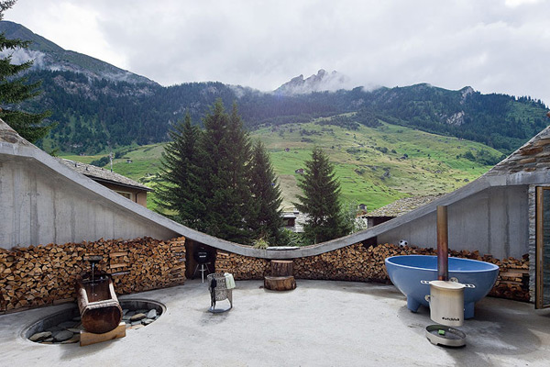
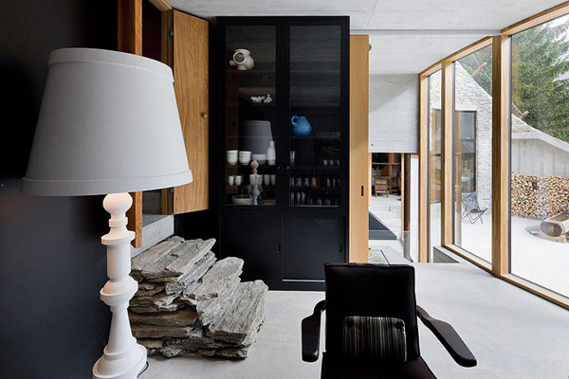
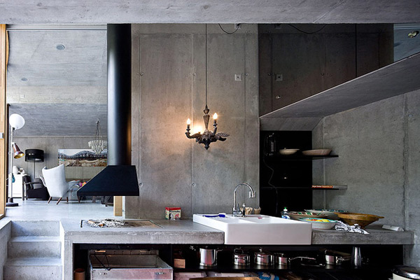
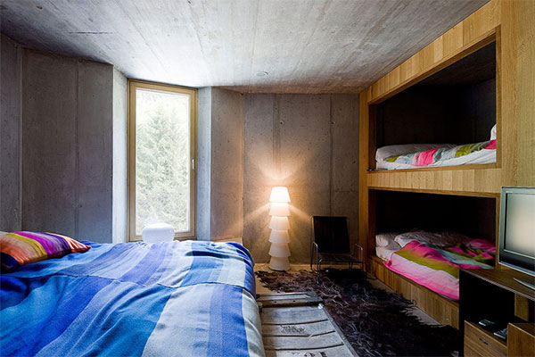
The house inside:

Slide 5
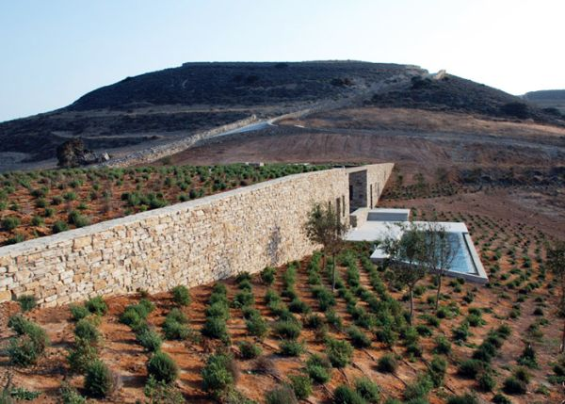
The Aloni House in the Cycladic Islands.
One way of making your home integrate into the landscape like it was part of it is to use the materials found in the area for the construction and to make the house disappear into the scenery. It’s why most hillside houses we’ve presented have been built into the hill and using locally-sourced materials such as stone or wood. The Aloni house has a design based on the same principles. However, the location is a little different from what we’ve seen so far. Located in this beautiful area of the Cycladic Islands, the house had to respond to the landscape that featured earth walls and farming areas. The designers from Deca Architecture decided to opt for a traditional typology for this project.

Slide 6
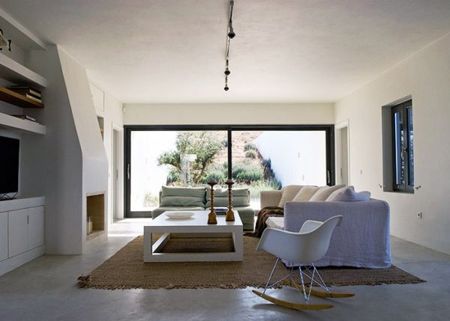
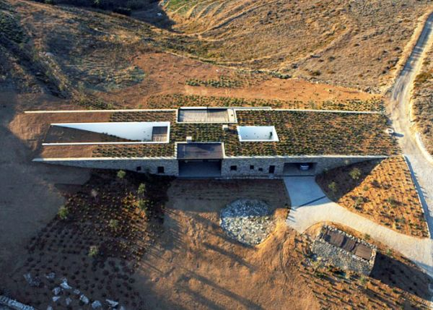
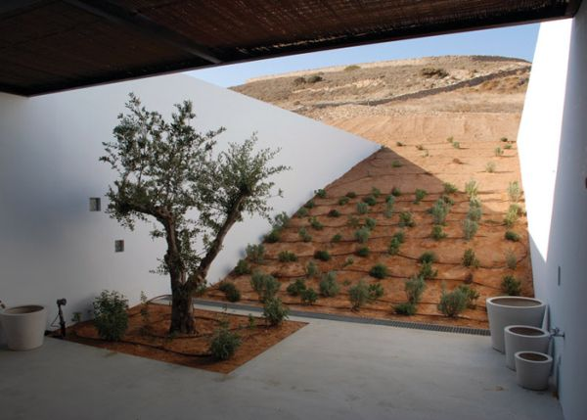
The house picture:

Slide 7
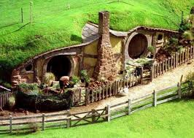
Advantages of having a buried house:
Advantages
“An earth-sheltered home is less susceptible to the impact of extreme outdoor air temperatures, so you won’t feel the effects of adverse weather as much as in a conventional house. Temperatures inside the house are more stable than in conventional homes, and with less temperature variability, interior rooms seem more comfortable.”
Other advantages include protection against the extremes of Mother Nature, such as high winds, hailstorms, tornadoes, hurricanes and earthquakes; less susceptibility to fire; lower insurance premiums; less maintenance; natural soundproofing; conservative use of land and natural resources.

Slide 8
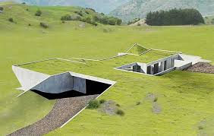
Disadvantages:
► There may be a psychological adjustment needed for a person shifting from a traditional over-ground house to an underground house.
► These houses are unconventional and require careful planning.
► One of the main problems with underground homes is that they can not be built in a flood-prone area.
► These houses require significant care to keep out moisture, both during construction and the life of the house.
► Due to the rarity of these houses, prospective customers may shy away from buying them. The mortgage application process may also be challenging for such houses.
► It is challenging to fit square appliances or frames which are designed for straight walls in underground houses because of the wall curvature.

