Slide 1
Presentation skills
HI !!!
I am Sonja and I’m 13 years old.
Have you ever wanted to go abroad, but you can't?
Don’t worry !!!
You don’t need to do this because you have it in Albania.
So, today, I want to talk about ...

Slide 2
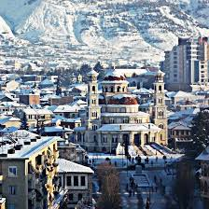
KORÇA

Slide 3
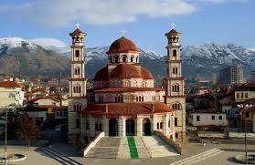
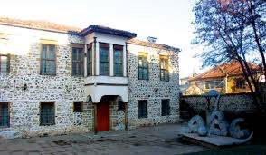
WONDERFUL PLACES
THE CATHEDRAL OF KORCA
Its size is considered the most important in Korça and the largest in Albania. Once in the same place there was another cathedral called St. George Cathedral, a building of historical importance, which during the 1968 anti-religious campaign was totally destroyed.
FIRST ALBANIAN SCHOOL
"First Albanian School" has returned to a museum which is now known as the National Museum of Education.This museum reflects the history of the script and of the Albanian book. The museum building has eight exposure environments.

Slide 4
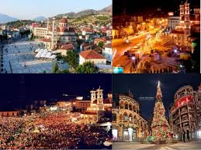
There are still many things to see ...

Slide 5
Climate
It has a climate mediterranean continental. Korca is very cold and freezing. Korça has a transitional with high temperature The hottest month is August (25 °C)while January (2 °C) is the coldest.
CLIMATE IN KORCA
Notes:
Medetireinin Tranxhishenell

Slide 6
Beer fest
BEER FEST

Slide 7
QUIZ
We will do a quiz...
What was the most important celebration? ____
Do you like Korca? Why? _________
What is the weather like in Korca? _________
What has climate in it? ________
Which was hottest month there ? _________
Which was coldest month there?___________

Slide 8
ENGLISH
Have you got any questions?
THANK YOU FOR YOUR TIME !!!

